Slide 1
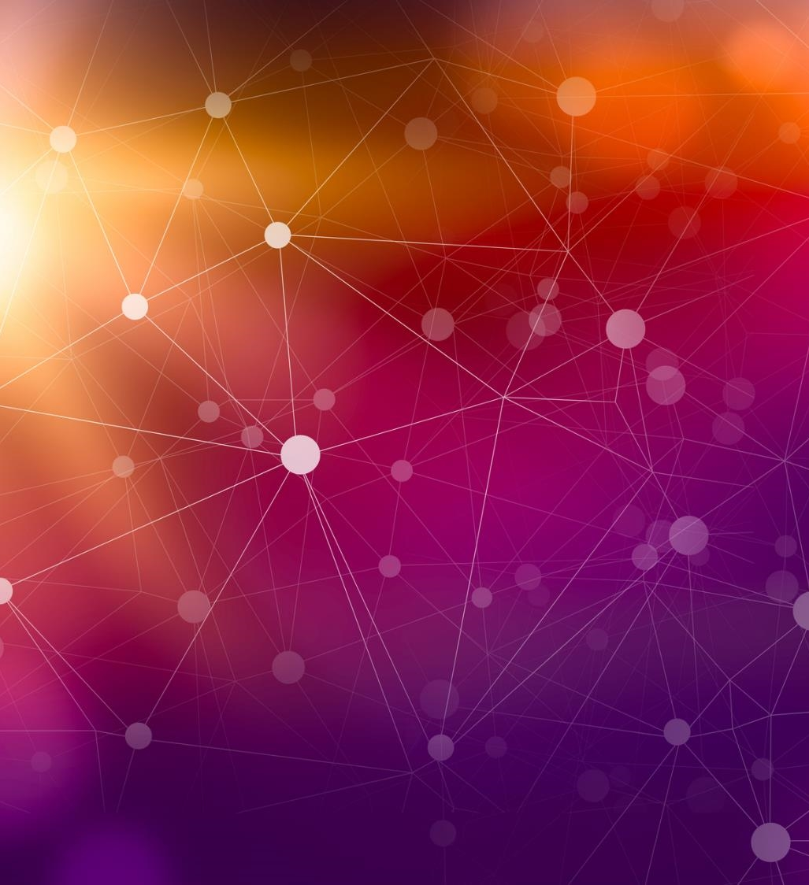
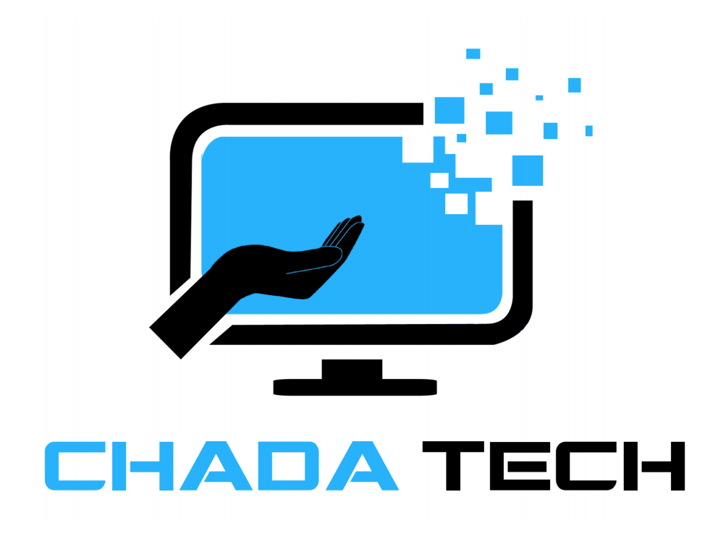
Scrum-Agile Development

Slide 2
Discussions
Agile Roles
Agile Phases
Waterfall Model
Waterfall vs. Agile
References

Slide 3

Agile Roles
Each role in the Agile Model plays a pivotal role in its success, from communication with the Client (Stakeholders) to the development of the final product.
Product Owner: The Product Owner is the connection between the Stakeholders and the rest of the team. Their job is to create the Product Backlog. Their job “ultimately leads to maximum value and team work.” (GeeksforGeeks, 2025)
Scrum Master: The Scrum Master is a “guide and mentor.” (GeeksforGeeks, 2025) Their role is to ensure that the impediments of the Developers are resolved. They also ensure that important meetings including the Daily Scrum are set, adhered to, and do not run over length. They help facilitate communication with the rest of the team.
Development Team: The Development Team is responsible for completing User Stories and testing the results to ensure a successful final product for the Stakeholders. They follow industry standards and work together to provide the most value in each Sprint.

Slide 4
Agile Phases
Agile methodology is a project management framework that breaks projects down into several dynamic phases, commonly known as sprints. (Laoyan, 2025)
1. Plan
2. Design
3. Develop
4. Test
5. Deploy
6. Review
Plan: The Product Owner works with the Stakeholders to determine the requirements, goals, and feasibility of the requested product. They also determine the expected completion date.
Design: Team members are chosen for the upcoming Sprint. A plan is then created on how development will be most effective to the completion of the final product.
Develop: The longest phase. Developer work on the User Stories in the Product Backlog to provide the final product meeting the needs just as requested by the Stakeholder.
Test: During this phase, the Development team tests the completed User Stories for clean code, removal of bugs, and that the User Story meets client needs.
Deploy: The final product is release for use in a live environment for use by clients and stakeholders.
Review: The final product is review and additional features can be discussed for the next Sprint. Feedback is provided and Phase 1 is returned to.
Agile Methodology

Slide 5
Waterfall Model
The Waterfall model is a linear, sequential approach to the software development lifecycle (SDLC) that's popular in software engineering and product development. (Kirvan, 2024)
Requirements
Analysis
Design
Coding
Testing
Deployment
Maintenance
The Waterfall model is designed to be a one and done process. During each step of the process, it is difficult to return to a previous step. Though this is an effective solution to software development, it does come with its own issues.
One example of the rigidity of this model is when a Stakeholder would like a change to be made to the product during the development. Implementing this change at anytime after the Coding phase would be difficult because all the development has already been completed. It would be hard to find where in the developed program the changes would need to be implemented. As such, a request like this might be denied until a new product development of the software begins.
It is important to have the entire product design locked in prior to development to ensure that the highest quality product be provided to the client.

Slide 6
Waterfall vs Agile
Agile project management takes an iterative approach to development by creating several incremental steps with regular feedback intervals.(Radigan, 2025)
The good:
Adapts to changes in client requirements
Promotes collaboration between team and client
Development time reduced
The Bad:
Final product changes during development
Training team to Agile is time consuming
Continuous development increases costs
When to use Agile:
It is a good idea to use Agile over Waterfall when requirements are not clearly defined or expected to change over the development cycle. If stakeholder feedback is critical to the success of the project Agile should also be considered.
The waterfall project management approach entails a clearly defined sequence of execution with project phases that do not advance until a phase receives final approval. (Radigan, 2025)
The good:
Clearly defined process results in less coordination
Costs of product development accurately created
Product design is finalized before development
The Bad:
Risk of time being wasted between phases
Difficulty sharing work because of specialized teams
Additional communication needed between phases
When to use Waterfall:
Using the Waterfall approach for projects with clear requirements that will not likely change. A clear final product, with strict deadlines that must be adhered to are also a good consideration.

Slide 7
References
GeeksforGeeks,.What is Scrum? Understanding the Agile Framework for Project Management. (2025, July 23). https://www.geeksforgeeks.org/software-engineering/what-is-scrum/
Laoyan, S. (2025, February 20). What is Agile methodology? (A beginner’s guide). asana. https://asana.com/resources/agile-methodology
Kirvan, P. (2024, November 15). What is a Waterfall model? Definition and guide. TechTarget. https://www.techtarget.com/searchsoftwarequality/definition/waterfall-model
Radigan, D. (2024, August 21). Project management intro: Agile vs. waterfall methodologies. Atlassian. https://www.atlassian.com/agile/project-management/project-management-intro

